Slide 1
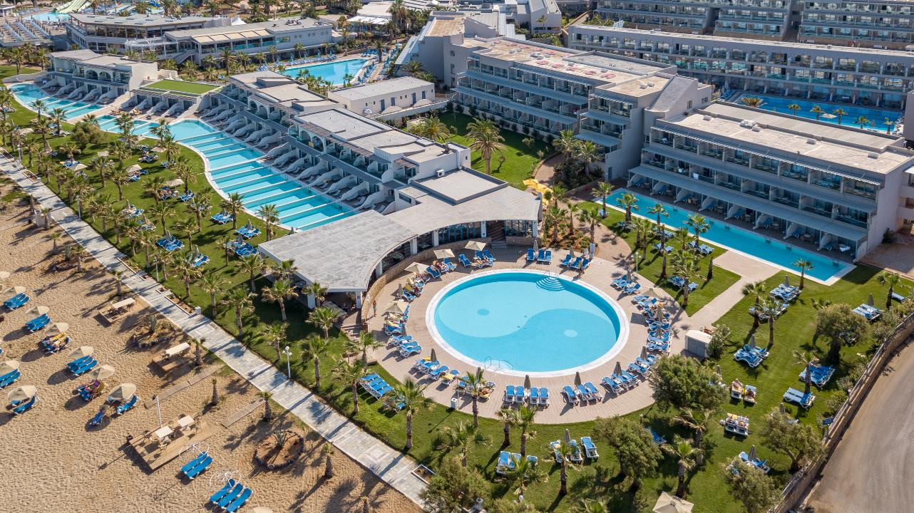
Lyttos Beach Sports

Slide 2
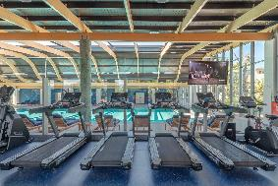
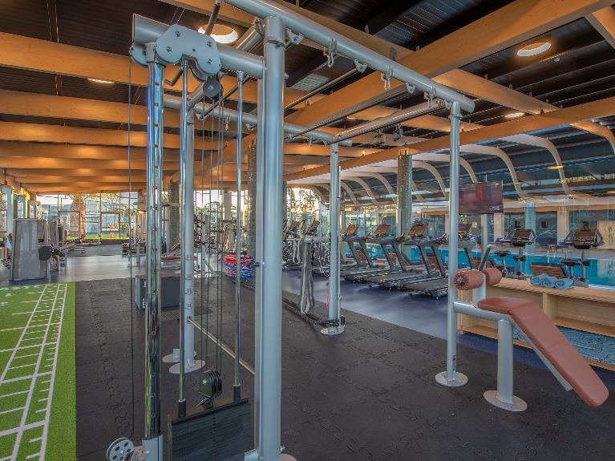
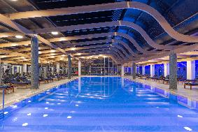
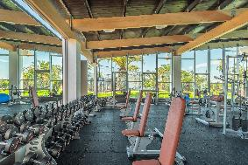
Gym
All new gym machines & equipment
Indoor Pool

Slide 3
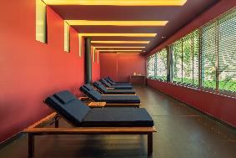
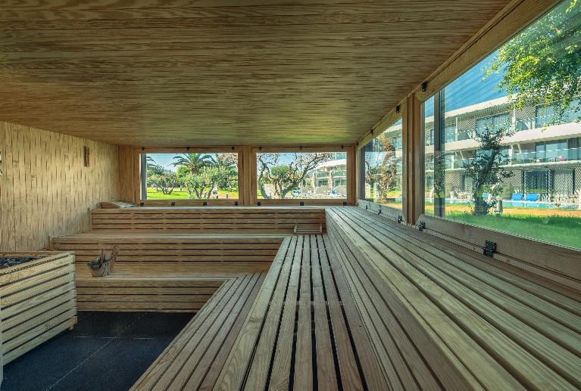
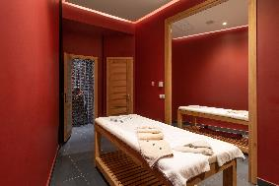
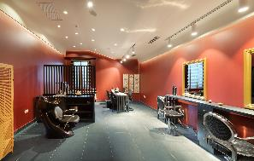
Spa
Massage
Sauna & Hammam
Hair Salon

Slide 4
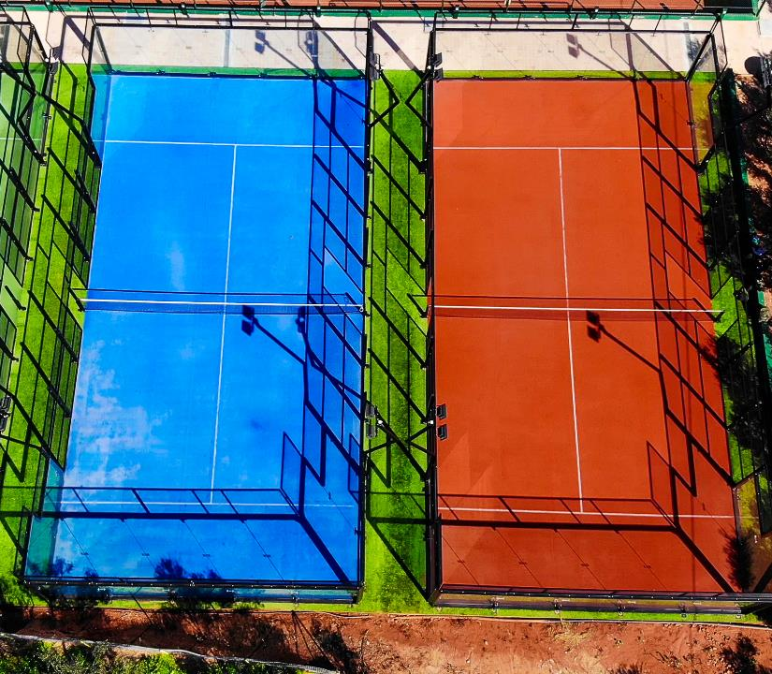
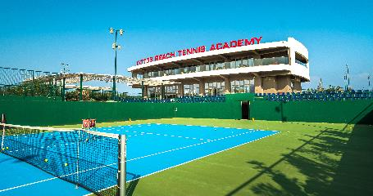
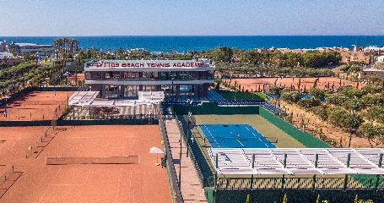
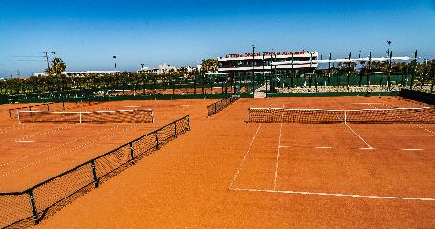
Tennis
12 Sand Courts
7 Hard Courts
4 Padel Courts

Slide 5
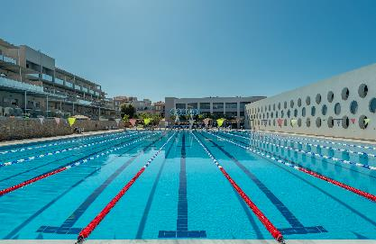
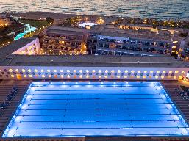
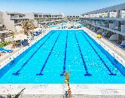
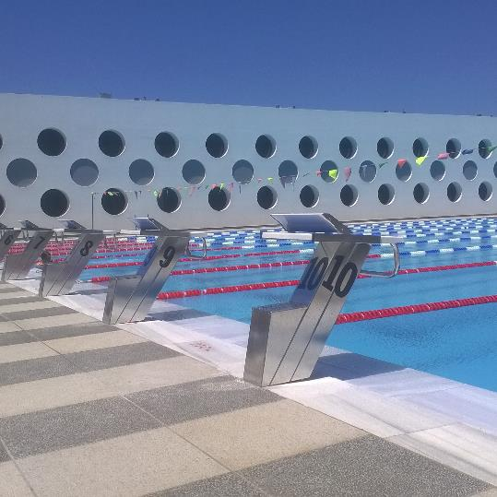
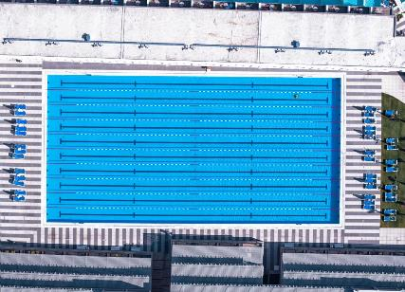
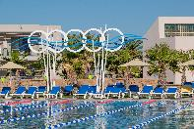
Water Sports
50 & 25m Olympic Pools
Internal Heating
Olympic Swimming
& Water Polo Standards

Slide 6
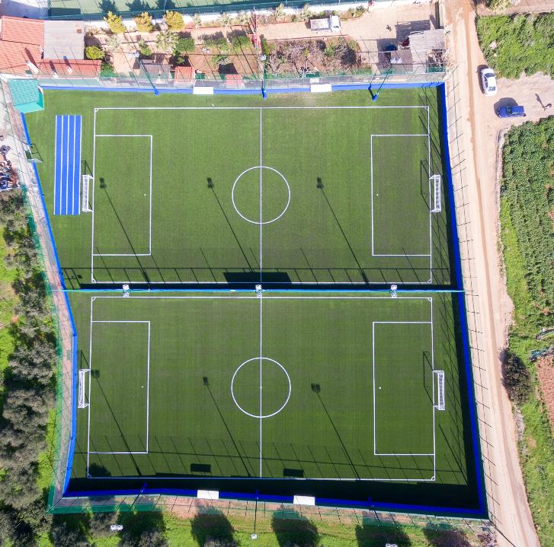
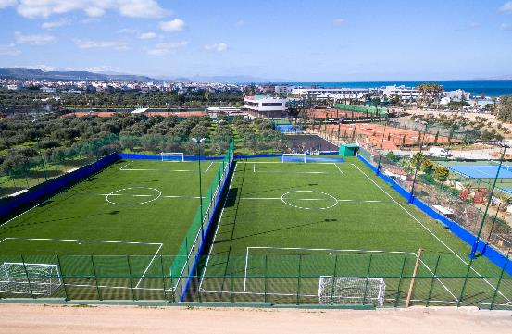
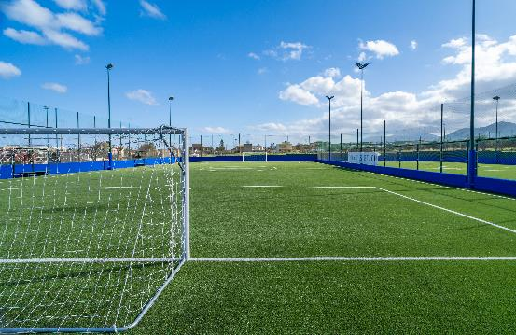
Football
2 8*8 Football Courts
Ultra Mix 50 Synthetic Turf
FIFA Quality PRO Standards

Slide 7
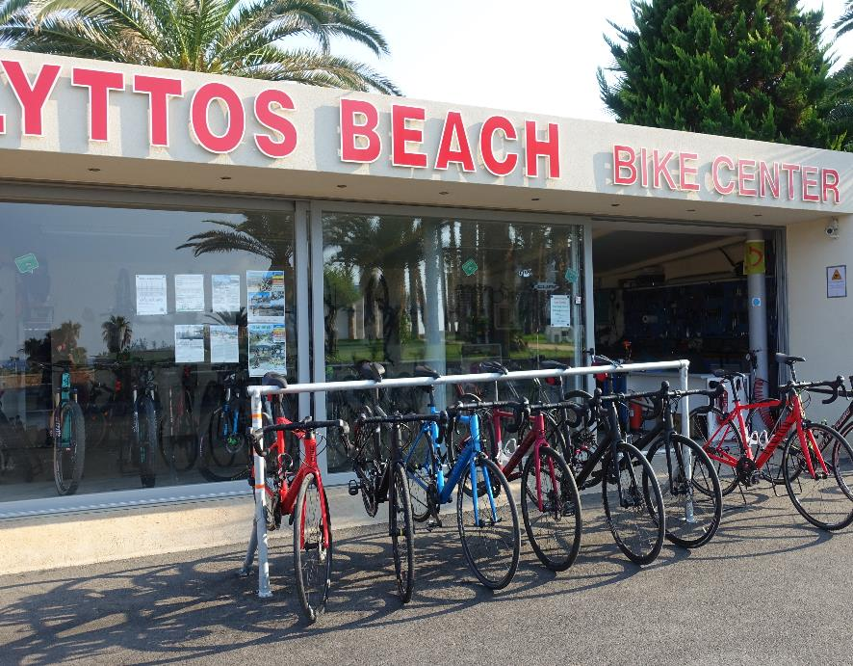
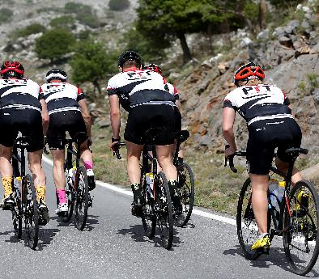
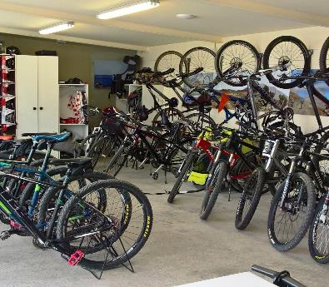
Cycling
Road Bikes
Mountain Bikes
E- Bikes
Storage Unit
Service Station

Slide 8
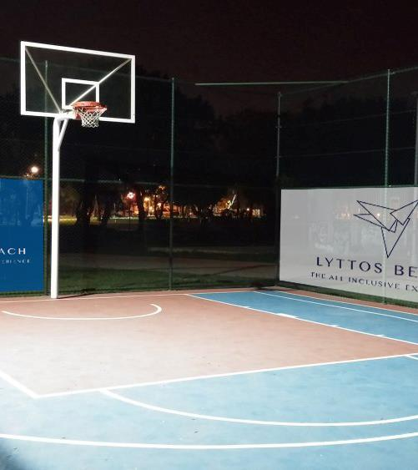
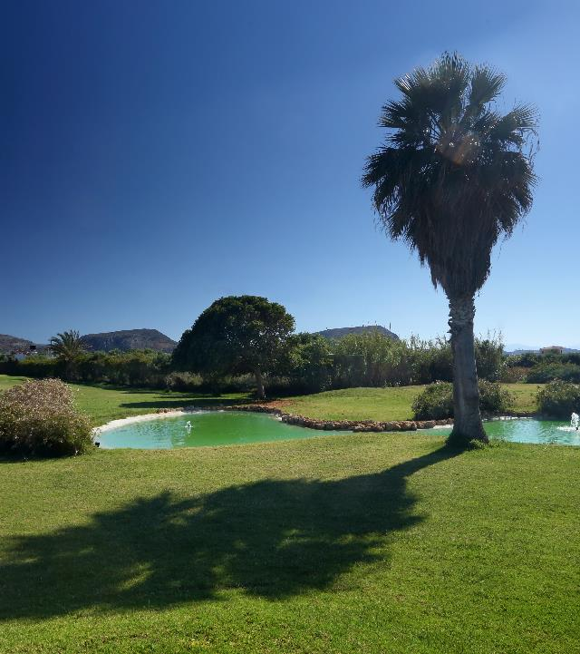
Basketball & Golf
Official Dimensions & Standards
Outdoor Basketball Court
3-Par Golf Field

Slide 9
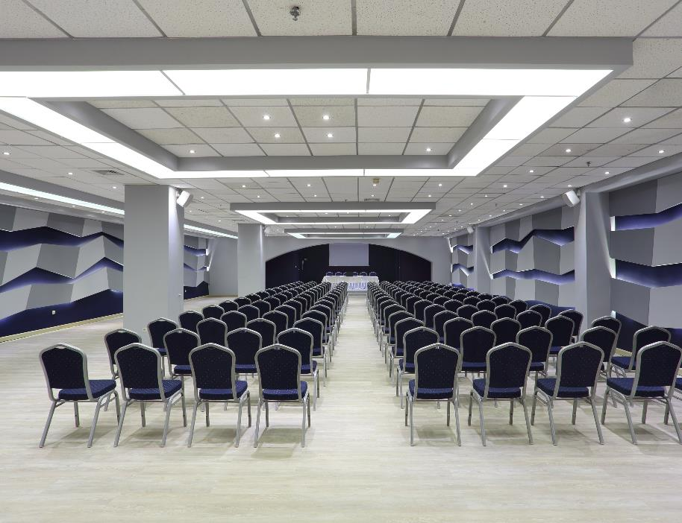
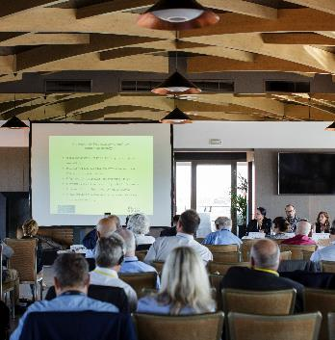
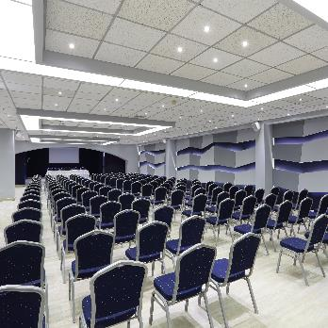
Conference
5 Fully equipped Conference
Rooms and Halls
Capacity up to 400 pax

Slide 10
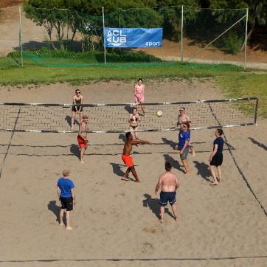
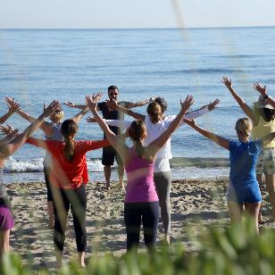
Other Sports
Ping Pong
Aerobics
Waterobics
Beach Volley
Beach Tennis
Voleyball
Chess
Archery
Martial Arts
Yoga & Fitness
Dancing
Fighting Sports

Slide 11
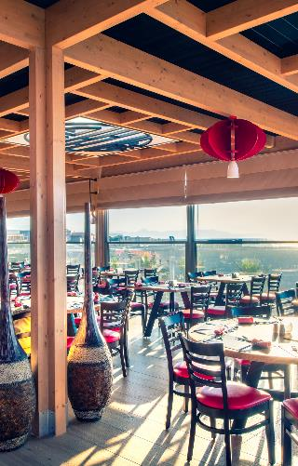
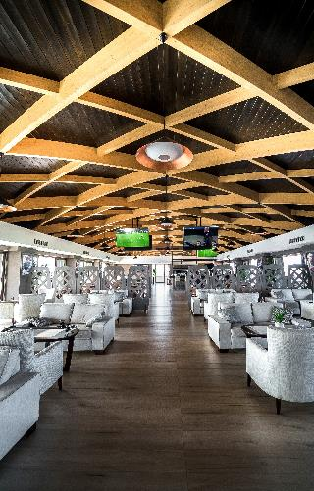
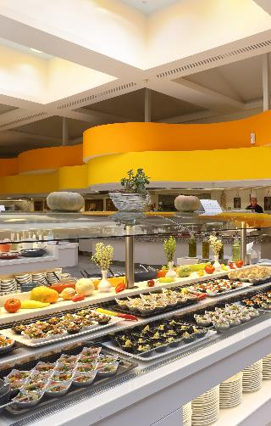
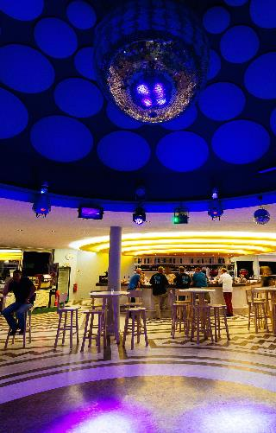
Bars & Restaurants
5 Restaurants
Local & Ethnic Cuisine
Snacks & Fast Food
5 Bars
Branded Spirits & Cocktails
Local and International Drinks

Slide 12
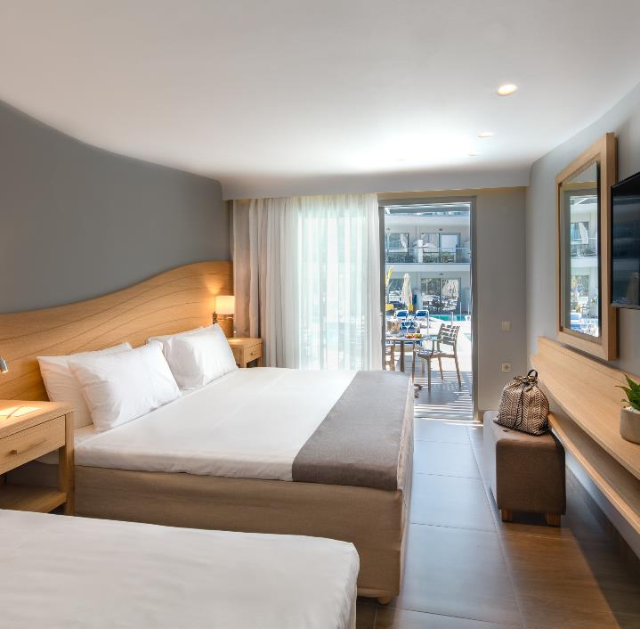
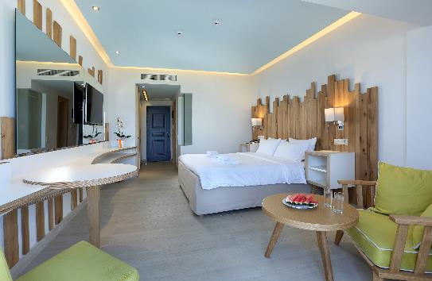
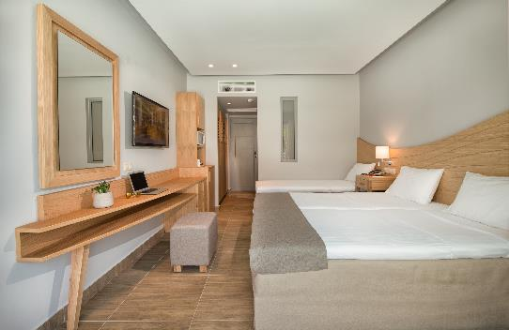
Accommodation
647 Rooms & Suites
96 Rooms with Pools
Double Rooms 1-3 persons
Family Rooms 2-6 persons
Junior suites 2-3 persons
Suites 2-5 persons

